Slide 1

EDUCATION FOR ALL (DONATION ANALYSIS & RECOMMENDATIONS)

Slide 2
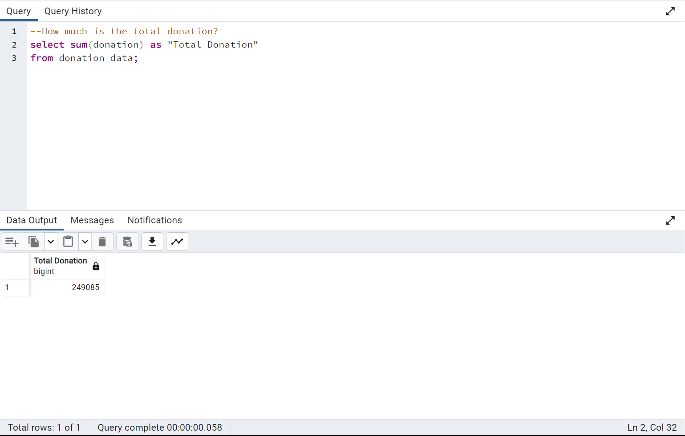
TOTAL AMOUNT GENERATED THE PAST YEAR

Slide 3
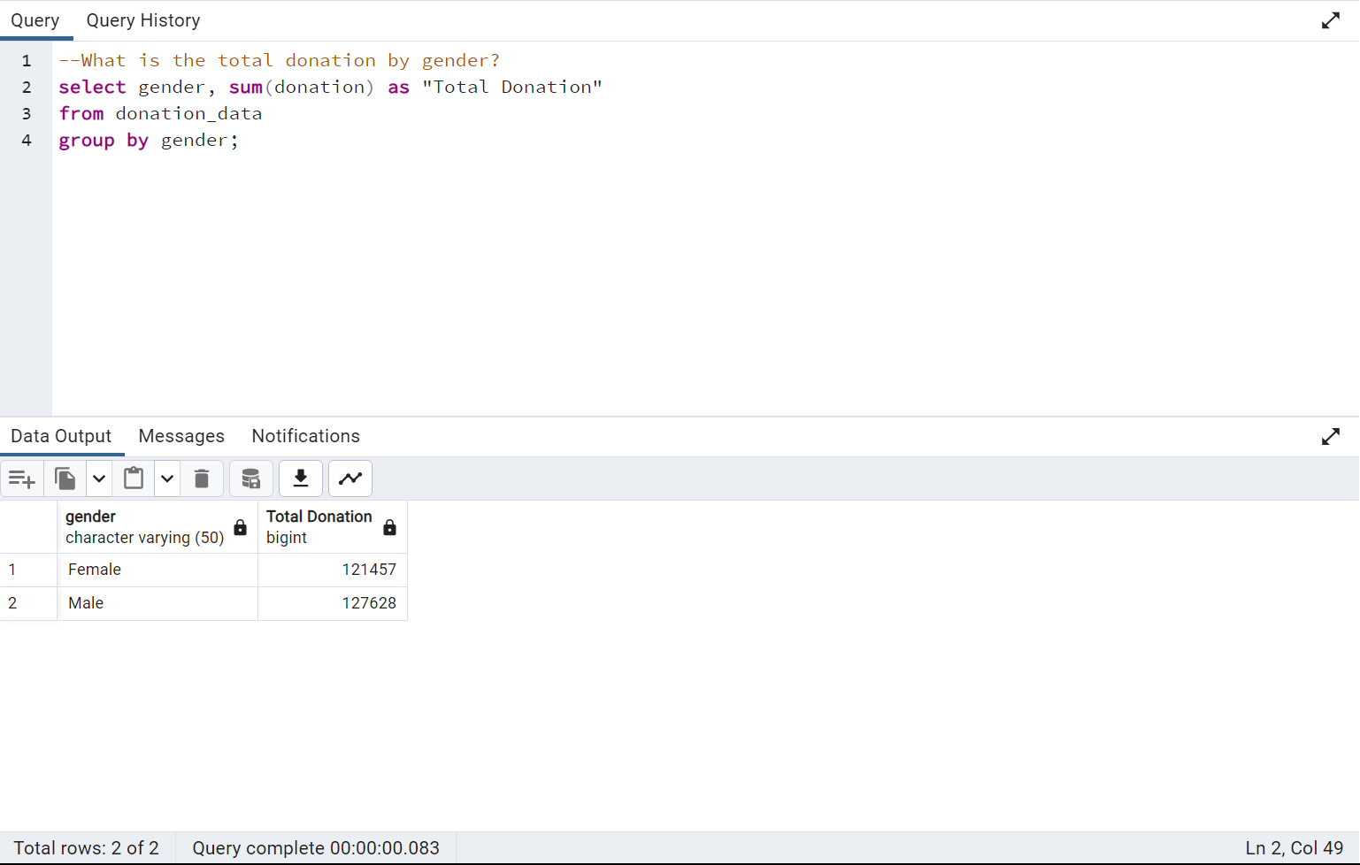
TOTAL DONATION BY GENDER

Slide 4
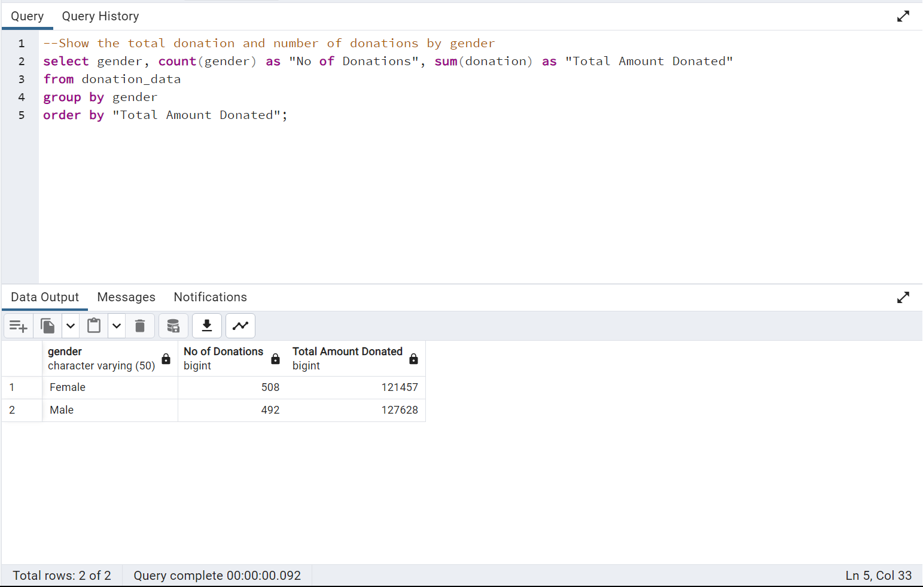
TOTAL DONATION AND NUMBER OF DONATIONS BY GENDER

Slide 5
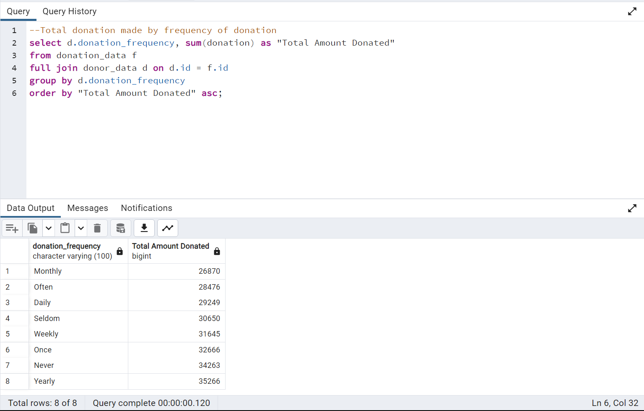
TOTAL DONATIONS MADE BY FREQUENCY OF DONATIONS

Slide 6
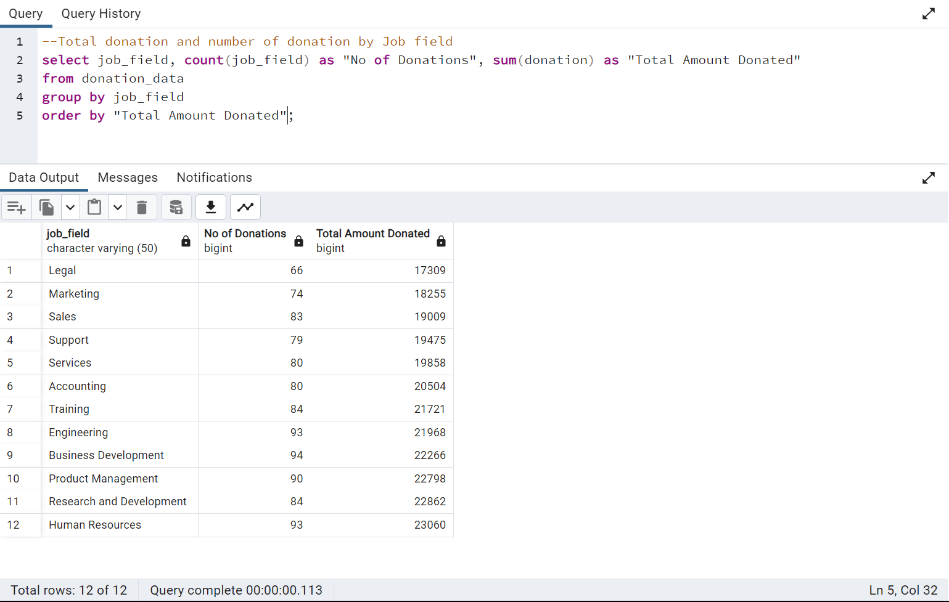
TOTAL DONATION AND NUMBER OF DONATIONS BY JOB FIELD

Slide 7
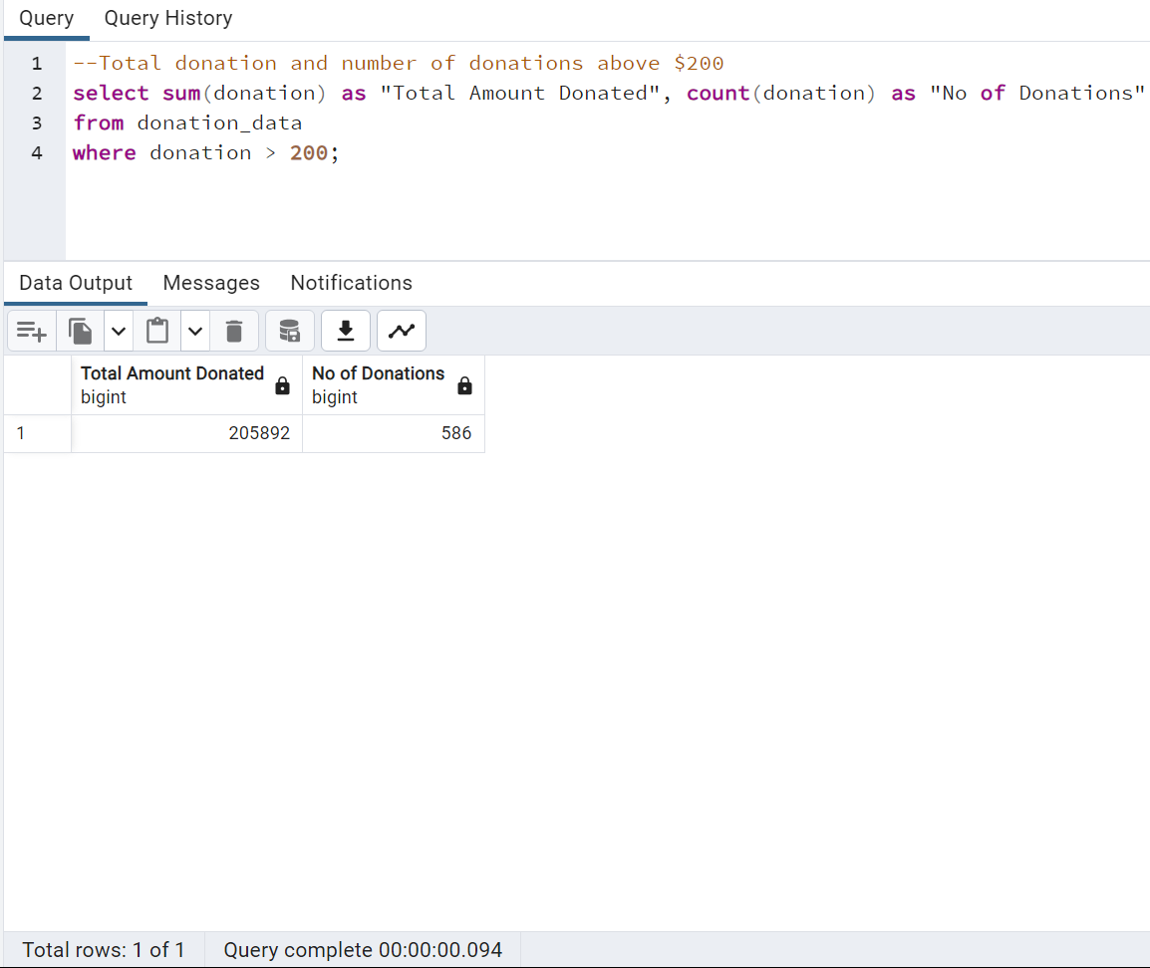
TOTAL DONATIONS AND NUMBER OF DONATIONS ABOVE $200

Slide 8
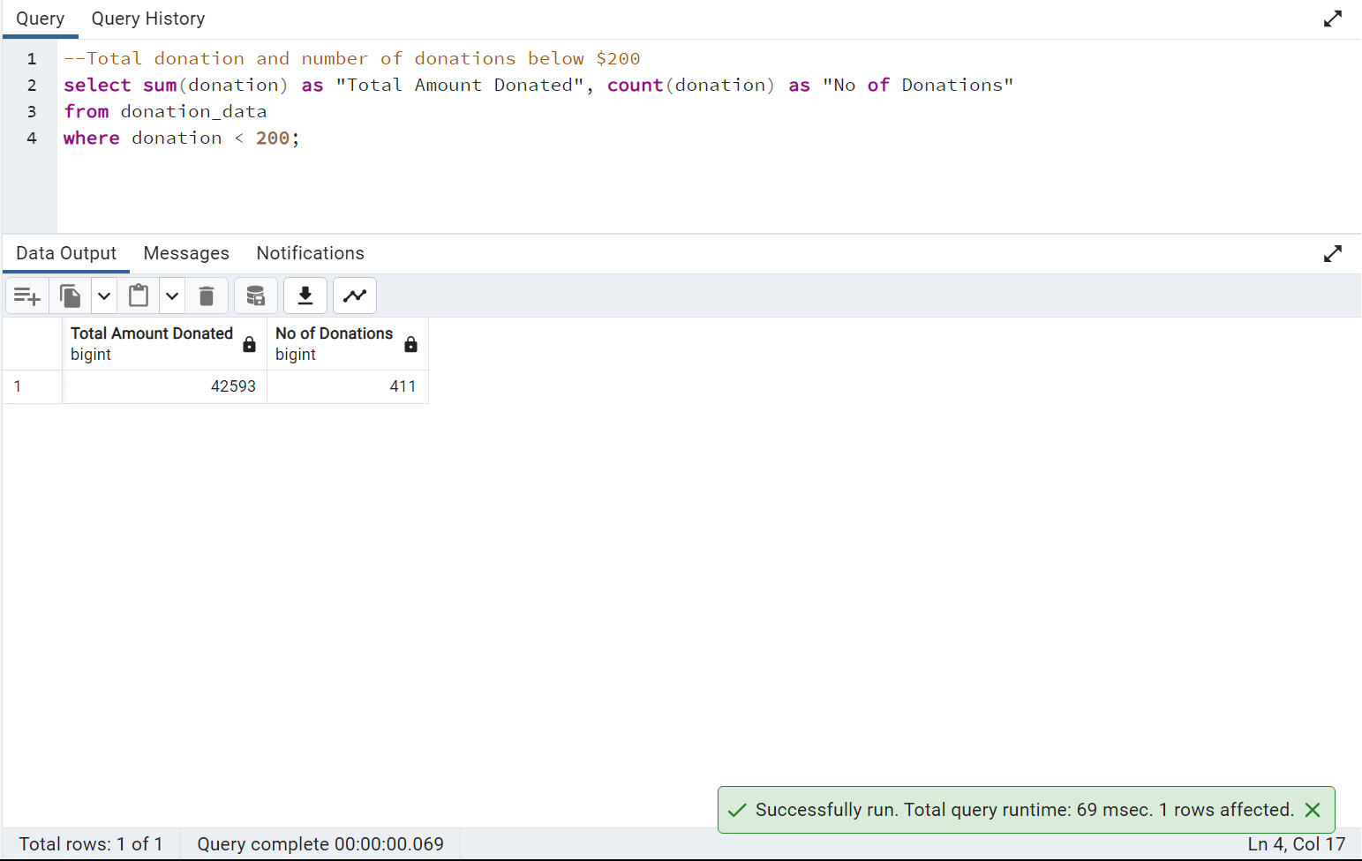
TOTAL DONATION AND NUMBER OF DONATIONS BELOW $200

Slide 9
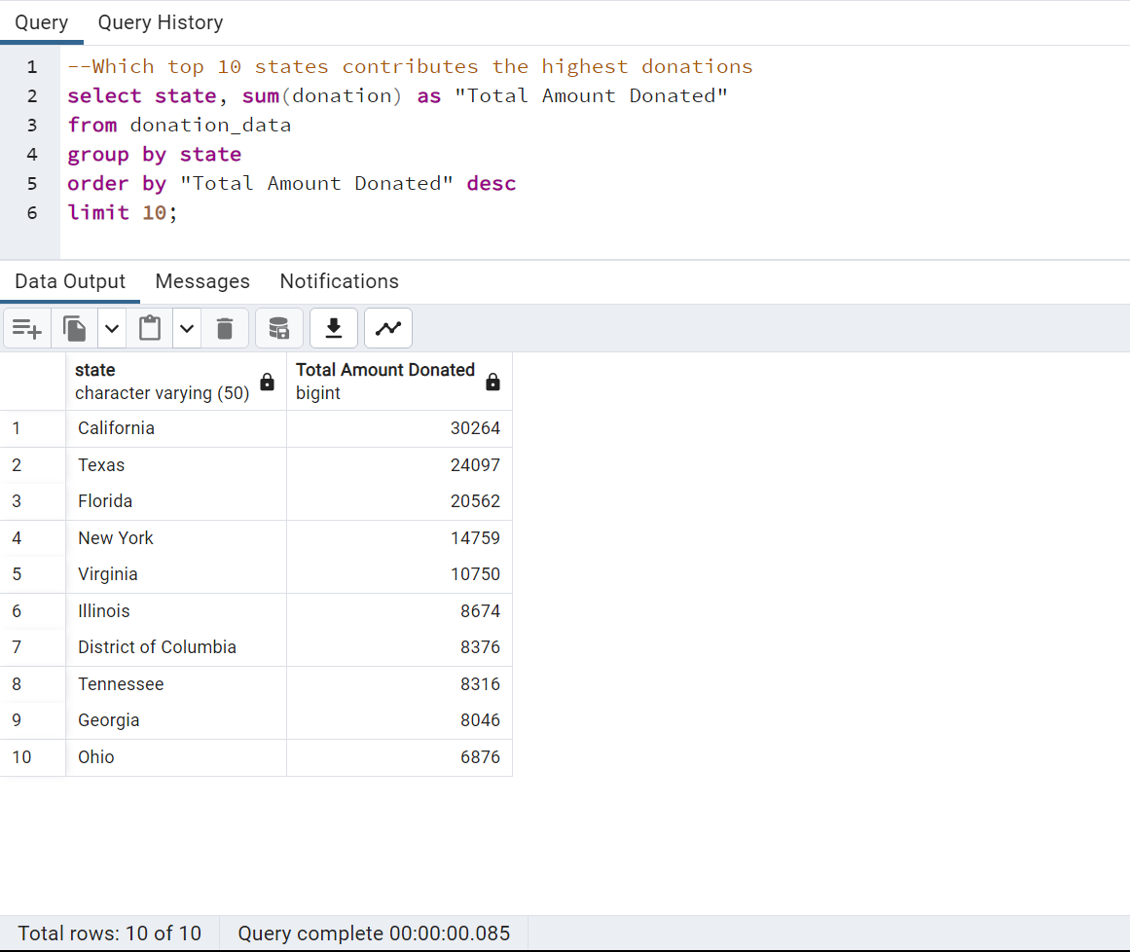
TOP 10 STATES THAT CONTRIBUTE THE HIGHEST DONATIONS

Slide 10
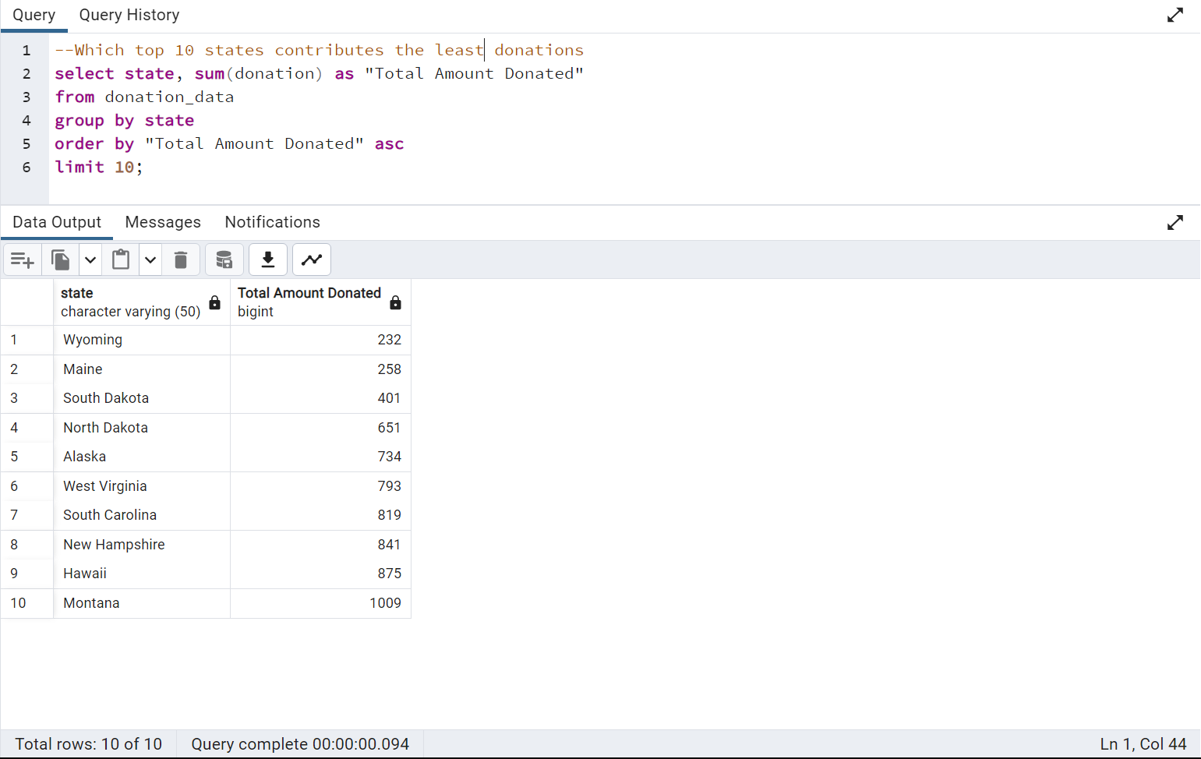
TOP 10 STATES THAT CONTRIBUTE THE LEAST DONATIONS

Slide 11
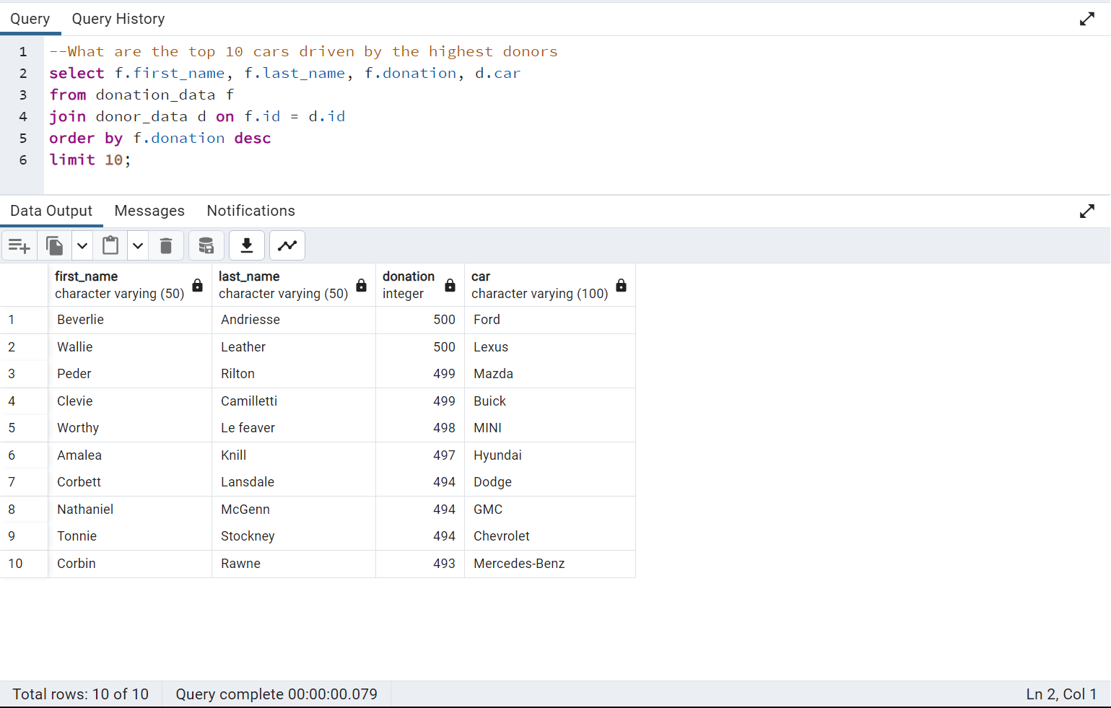
TOP 10 CARS DRIVEN BY THE HIGHEST DONORS

Slide 12

INSIGHTS
The total amount generated during the last donation drive was $249,085;
The total number of donors was 1,000;
There were more female donors compared to the male donors by a difference of 16;
However, the male donors generated more money compared to the females by a difference of $6,171;
The yearly donors generated the highest amount of money while the monthly donors generated the least;

Slide 13

INSIGHTS
Donors from the HR department generated the highest amount of money while donors from the Legal department generated the least;
More than 50% of the donors donated above $200;
The top 3 states with the highest donations are California, Texas, and Florida;
The 3 least donating states are Wyoming, Maine, and South Dakota with total amounts less than $500;
The highest amount donated by an individual is $500;

Slide 14

RECOMMENDATIONS
Aside from the website where individuals can donate to the cause at any time, the organization should start a quarterly auction/sales drive to encourage donors to participate more;
The auction would create healthy competition amongst the donors and would boost the value of the donations;
The minimum donation amount should be fixed at $50 as opposed to $5;

Slide 15
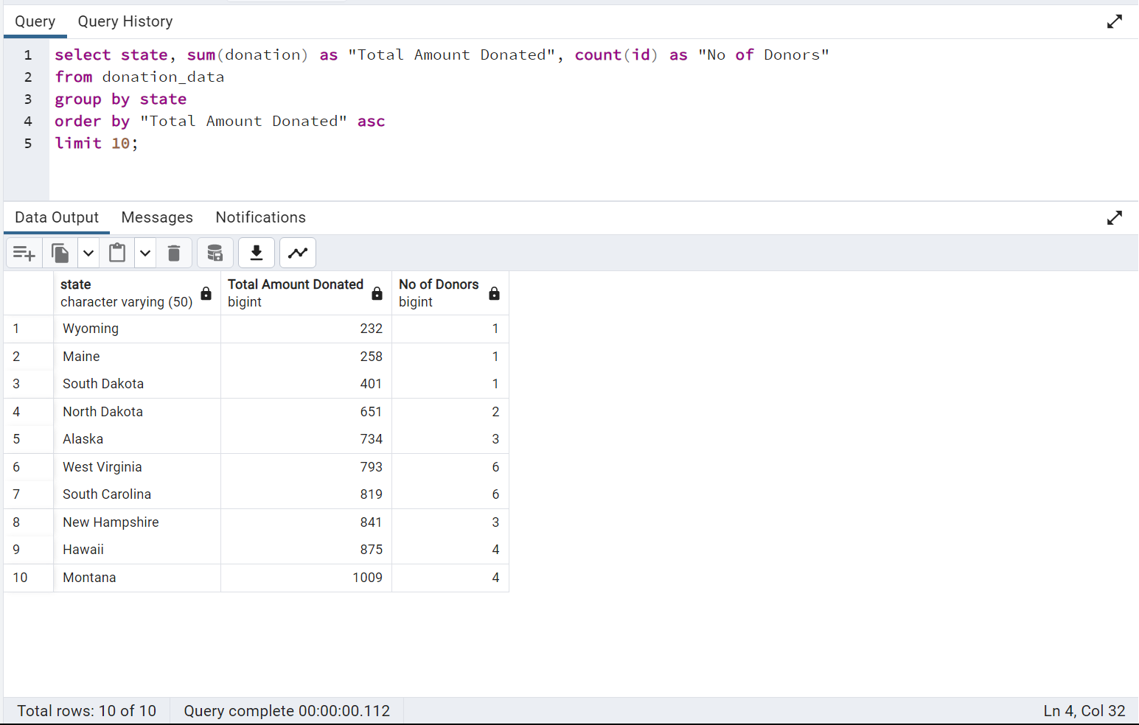
RECOMMENDATIONS
Encouraging more people to donate in the top 10 least performing states would boost the total amount of donations generated;
The quarterly auctions and sales drive should be targeted at the states that contribute the least donations;

